Slide 1
Policy on PrEP in SRH services and trials:
The South African experience
Sinead Delany-Moretlwe, MBBCh PhD
University of the Witwatersrand
IAS, 26 Jul 2018

Slide 2

WHO recommends PrEP
  TDF/FTC licensed for PrEP in >40 countries
  Included in WHO Essential Medicines List
  Roll-out to priority populations
  Variable coverage within and across countries
WHO, 2015; www.prepwatch.org
Notes:
Recommendations based on systematic review of 12 randomised controlled trials of oral PrEP effectiveness conducted in a range of different populations worldwide
PrEP was effective in reducing HIV risk across age, gender, ARV regimen (TDF versus emtricitabine (FTC) + TDF) or mode of acquiring HIV (rectal or penile/ vaginal).

Slide 3
Truvada approved for PrEP in SA
SA NDOH convened a PrEP Technical Working Group to provide technical assistance on plans for implementation October 2015
Notes:
As the use of the fixed-dose combination of tenofovir disoproxyl fumarate and emtricibine represents a departure from the usual use of these antiretrovirals for the treatment of HIV infection, the MCC has also requested the applicants to implement a risk management plan, which requires applicants to provide prescribers with a detailed information pack, to gather data on adverse effects, and to report these to the MCC at 6-monthly intervals.

Slide 4
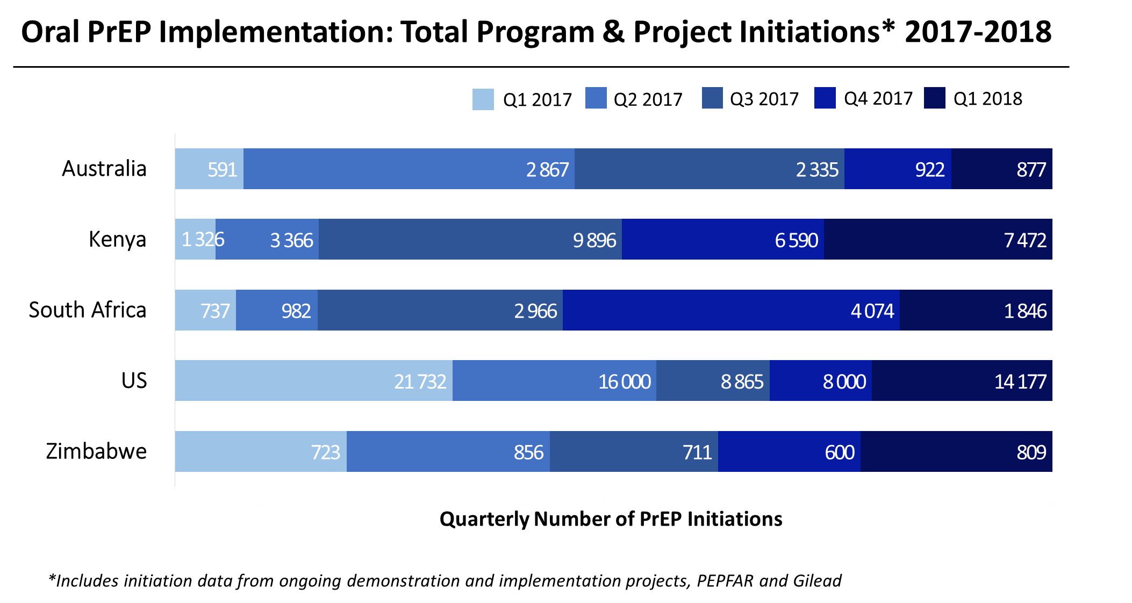
PrEP implementation: progress
NDOH delivery sites have scaled up from 11 in 2016 to 30+
Notes:
Phase approach with populations
Incomplete provincial coverage
Majority of initiations in Gauteng, followed by KZN and W. Cape
Constrained to some degree by funding.
Current expansion for AGYW with partners funded by CDC, PEPFAR or GFATM
Offered as part of a comprehensive package of prevention

Slide 5

Implications for trials in SA
Issue = access to TDF/FTC variable
Avoid perverse incentives for enrolment
Ensure sustained access post-trial
Not currently the standard of care
Implications for cost and trial size
Access to best available standard of prevention
Avoid inequities between sites and within communities
Needed to build country consensus → summit Nov 2017
Notes:
Variable implementation
TDF/FTC licensed for PrEP in >17 countries
Roll-out to priority populations
For trials, access is variable and site specific
PrEP works for women and men, and is licensed for use in many of the countries where studies are being done
We don’t know if a study product is protective and some participants may be on placebo i.e. not protected
perceived inequality to not allow members of the public at sites to access this PrEP if NOT eligible for study participation. In addition, some sites may have different HIV prevention trials being executed at the same site e.g. AMP, ECH and HVTN 702, and having variable access to PrEP may not only impact on equity, but on inducement, should on the HIV vaccine trials provide PrEP. Further, ongoing post-trial access would not be feasible as the human resource, infrastructure and financing of these clinical trials have definite life spans.

Slide 6
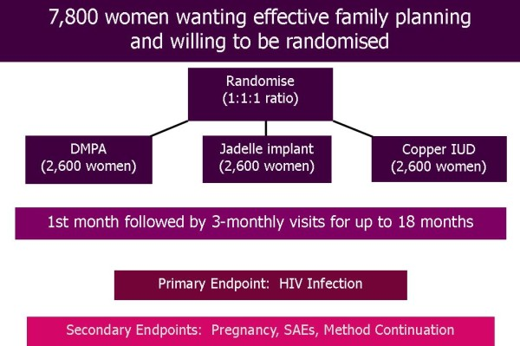

Should PrEP be offered in ECHO?
Source: http://echo-consortium.com/study-design/
Notes:
Additional concerns about cost

Slide 7
Should PrEP be offered in ECHO
For
Women in a study like ECHO are at risk for HIV, some/many at “substantial risk”
Against
ECHO is *not* an HIV prevention study, although we clearly want to do our best to prevent HIV in all participants
PrEP is new and studies like ECHO offer an opportunity to test/demonstrate new things
Ongoing contact with expert health providers in ECHO could offer a way to provide PrEP
Use of PrEP can be planned for and controlled for in the final analysis
PrEP is not part of national prevention policies (even in countries where there is regulatory approval)
Providing PrEP ahead of national policies could make the ECHO population unlike its population (generalizability)
If provided, ECHO can’t guarantee access to PrEP after the trial
Based on national data, uptake may be low initially
Notes:
Additional concerns about cost

Slide 8
Summit on Standard of Prevention
5-6 Nov 2017, Cape Town
Conclusions
Standards of Care in clinical trials in our settings are complex, often vary from site to site
International and local guidelines can inform provision of PrEP in HIV prevention trials.
The use of PrEP for high-risk women and men in the country is likely the aspirational Standard of Care.
PrEP introduction into trials requires REC and community support.
Notes:
Policymakers, regulators, ethicists, experts in the law (as it pertains to medical research) and researchers involved in both HIV and Cancer presented a framework within which Standard of Care principles could be articulated. How and when to include new modalities of treatment and prevention into existing essential medical guidelines was the emphasis of the Summit. Participants involved in the execution of care and the scale up of new interventions, in particular, the roll out of Pre-exposure Prophylaxis, presented the opportunities and challenges when it comes to scaling up interventions, and their experience with demonstration projects of PrEP. Advocates and community members propagated the need to make interventions that could avert HIV infection available as soon as possible. Experts in evidence-based guideline development discussed the nuances in evaluating evidence for policy and the mechanisms for getting medicines on the essential medicine list in South Africa. Given the variability in efficacy in PrEP amongst different populations, scientists and statisticians, discussed the various biological, virological and immunological reasons for this heterogeneity. Input was given as to the impact of introducing PrEP in other HIV prevention trials, and the considerations for the design of both ARV based and non-ARV based HIV prevention trials.

Slide 9
Summit on Standard of Prevention
Recommendations
Establish an SAMRC-initiated PrEP fund to make PrEP available to trial sites; provision for immediate procurement
Manner in which PrEP is provided will be left for sites with community to decide.
PrEP provision limited to the duration of the study, post-trial access could not be supported, participants are made aware of this restriction.
Work the NDoH PrEP technical working group to motivate support of demonstration projects close to the sites.
Develop information to optimise the efficacy of PrEP.
Notes:
Policymakers, regulators, ethicists, experts in the law (as it pertains to medical research) and researchers involved in both HIV and Cancer presented a framework within which Standard of Care principles could be articulated. How and when to include new modalities of treatment and prevention into existing essential medical guidelines was the emphasis of the Summit. Participants involved in the execution of care and the scale up of new interventions, in particular, the roll out of Pre-exposure Prophylaxis, presented the opportunities and challenges when it comes to scaling up interventions, and their experience with demonstration projects of PrEP. Advocates and community members propagated the need to make interventions that could avert HIV infection available as soon as possible. Experts in evidence-based guideline development discussed the nuances in evaluating evidence for policy and the mechanisms for getting medicines on the essential medicine list in South Africa. Given the variability in efficacy in PrEP amongst different populations, scientists and statisticians, discussed the various biological, virological and immunological reasons for this heterogeneity. Input was given as to the impact of introducing PrEP in other HIV prevention trials, and the considerations for the design of both ARV based and non-ARV based HIV prevention trials.

Slide 10
ECHO Protocol
  The ECHO protocol allows PrEP use:
5.9 HIV Prevention Package
At each visit, study staff will counsel women on HIV risk reduction including use of dual methods for prevention of pregnancy and STI, provide HIV testing and screening, syndromic treatment for STIs and offer them male and/or female condoms. We will also offer partner testing and counselling to any study participant that desires it including women who are in discordant partnerships. HIV serodiscordant couples will be counseled about ART for HIV risk reduction and referred for ART initiation at local service partners. If, during the course of the study, other new effective prevention strategies are incorporated into national HIV prevention policies (e.g., oral pre-exposure prophylaxis), study participants will be counselled about these interventions, and referred to local centres with appropriate expertise, in accordance with WHO/UNAIDS guidelines and local practice and stakeholder consultation. Thus, both post- and pre-exposure prophylaxis will be offered, either on site or by referral, per local standard of care /national policy. The study team is committed to ensuring that participants are aware of and have the option to access optimal HIV prevention tools, in accordance with local practice and standards. Use of HIV prevention strategies will be recorded on case report forms.
…All sites in SA trained in PrEP delivery, PrEP procured

Slide 11
Conclusions
PrEP has become part of the evolving HIV prevention landscape in South Africa
Given variable access across the country it was important to develop a national consensus on the issue
South African summit created framework and resources for providing PrEP within trials
Community involvement was critical to agreements around post-trial access to PrEP
Several placebo-controlled trials, including an SRH trial like ECHO, are now offering PrEP as part of the standard of prevention
Offer of PrEP within trials must include appropriate materials and staff support to make PrEP uptake meaningful

Slide 12
Acknowledgements
Helen Rees
Glenda Gray
MRC Standard of Prevention Summit 2017 participants
Trial participants

